Slide 1
Android Volley
Nisar Ahmed Siddiqui

Slide 2
Android Volley
Volley is an HTTP library that makes networking for Android apps easier and most importantly, faster. Volley is available on GitHub.
Volley offers the following benefits:
Automatic scheduling of network requests.
Multiple concurrent network connections.
Transparent disk and memory response caching with standard HTTP cache coherence.
Support for request prioritization.
Cancellation request API. You can cancel a single request, or you can set blocks or scopes of requests to cancel.
Ease of customization, for example, for retry and backoff.
Strong ordering that makes it easy to correctly populate your UI with data fetched asynchronously from the network.
Debugging and tracing tools.

Slide 3
Volley Continued
Volley excels at RPC-type operations used to populate a UI, such as fetching a page of search results as structured data
Supports raw strings, images, and JSON.
Not suitable for large download or streaming operations.
For large download operations, consider using an alternative like DownloadManager

Slide 4
Types of requests
JsonObjectRequest — To send and receive JSON Object from the server
JsonArrayRequest — To receive JSON Array from the server
ImageRequest - To receive an image from the server
StringRequest — To retrieve response body as String (ideally if you intend to parse the response by yourself)

Slide 5
Gradle Implementation
dependencies {
implementation("com.android.volley:volley:1.2.1")
}

Slide 6

Add the INTERNET permission
To use Volley, you must add the android.permission.INTERNET permission to your app’s manifest. Without this, your app won’t be able to connect to the network

Slide 7

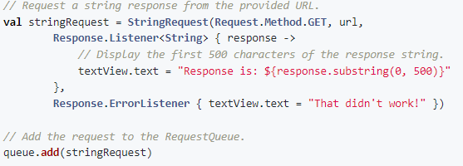
Steps
Creating a Request Queue
Passing it a request

Slide 8
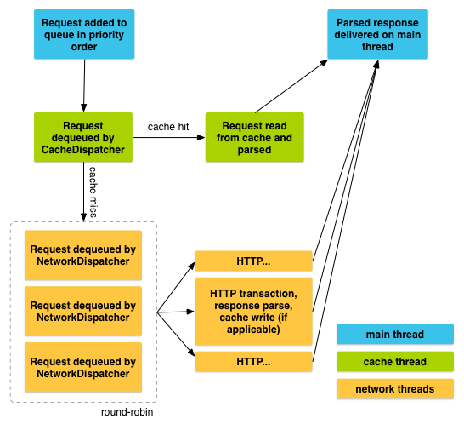
Life of a request

Slide 9
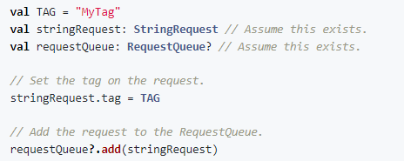

Cancel a request
To cancel a request, call cancel() on your Request object

Slide 10
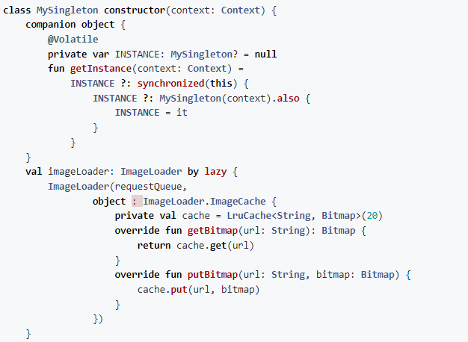
Image Loader Example – part 1

Slide 11
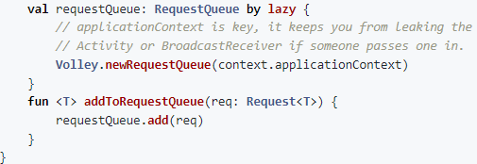
Image Loader Example – part 2

Slide 12
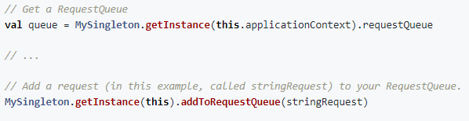
Using singleton class

